Slide 1

DiamLah!
By Super IVLE Boy

Slide 2
Concepts

Slide 3
Why DiamLah! ?
It is common to see students forgetting to silent their phones during lessons.
Annoyance to both teacher and other students.
Then some students will ask you to diam lah(shut up)!
But not their fault, it is so troublesome that they may forget.

Slide 4
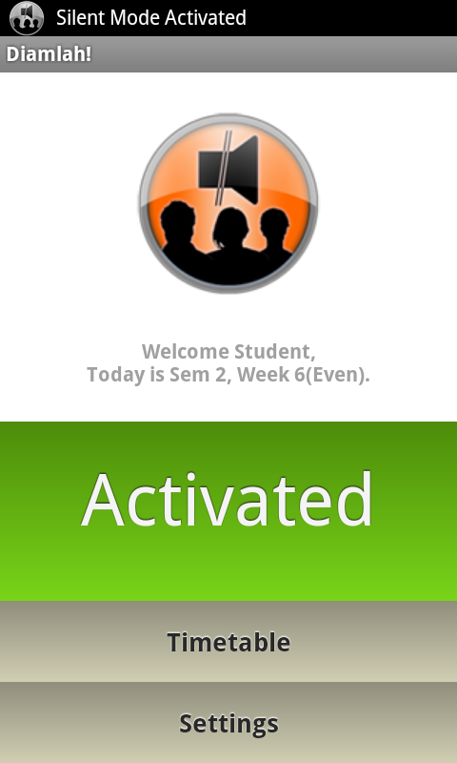
What is DiamLah! ?
An app that silences the phone according to a student’s timetable from Student Info API.
Automates the repeated task of silencing and unsilencing of phone.

Slide 5
Usefulness
The user only have to run the application one time and everything will be handled by the app.
The user do not need to access the application, unless he/she wants to change the settings

Slide 6
Key Features
Customizable Timetable
Auto Reply SMS System
Sleep Mode
Notes:
Good Morning Judges, my name is Wei Rong. Today, I will be touching on the key features of the application, the interface, and lastly a demonstration on the applciation.
First, let’s us start with the key features. Diamlah! has customizable timetable feature, auto reply sms and sleep mode features.

Slide 7
Customizable Timetable
Students can add, modify and remove any schedules.
Flexibility
Students might skip lessons (not encouraged though)
Students might attend lessons not reflected in the system.
Students might add other weekly events beside lessons.
Notes:
We begin with the customizable timetable. For this application, we would want it to be as flexible for the students as possible. Besides getting the stduents schedules from the api, it would be better for students to add, modify and delete any of the schedules in the timetable. Three reasons why fleibility is important. First, students might skip lesson. There have been situations in which students change their tutorial lesson and not reflected in the official timetable. Students might also add their personal events such as CCAs, meetings etc…

Slide 8
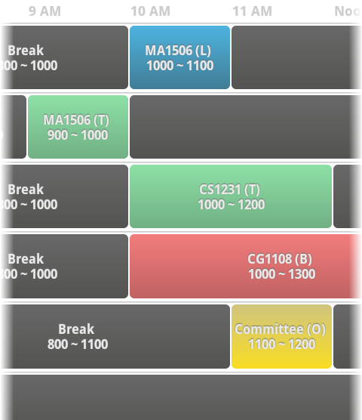
Some Features in the Timetable
Coloured Schedules
Differentiates between types of lessons
Timeline-feel Timetable
Starts at 8am and ends at 12mn
Students do not have to scroll a lot
Notes:
Here are some of the things you will see in the timtable.
1. The lessons are colored according to the lesson types for easy reference.
2. It is easy to navigate as the timetable resembles a timeline-feel. Timetable begins at 8am and ends at 12mn.

Slide 9
Auto Reply SMS System
Once silent mode is activated, students might not be aware of incoming call.
Auto Reply SMS system sends a SMS message to caller.
SMS message customizable.
Option to set frequency of auto-reply SMS.
Notes:
Next, we have also came up with an automatic reply sms system. Once the silent mode is activated, students might not be aware of the incoming call. Hence, auto reply sms system is designed to send a sms message to the caller. The sms message is customiable by the user. User can also have the option to set the freq of the autoreply sms.

Slide 10
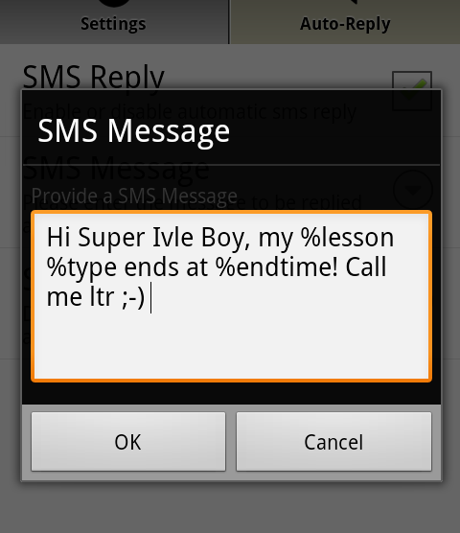
Tokens IN Auto Reply SMS System
Tokens provide information to the caller.
%starttime
%endtime
%lesson
%frequency
%type
Notes:
We tried to think further. How about making a sms more dynamic? Hence, we came up with this tokens. In the auto reply sms system message, user can key in pre-assigned keywords to further provide callerwith the information.

Slide 11
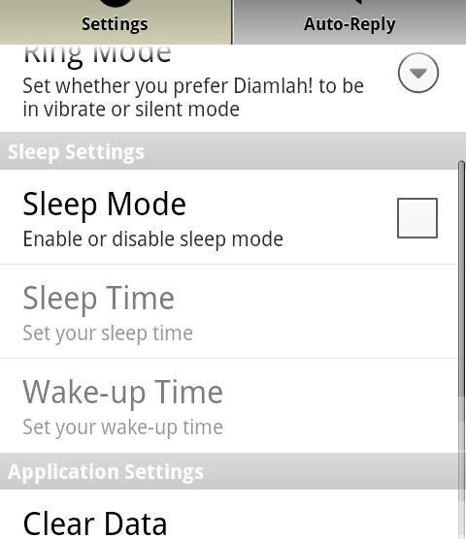
Sleep Mode
Phone to be in silent mode throughout the sleep mode.
Not a weekly event.
For students who do not wish to pick up call at certain period of the day
E.g. In laboratory
Notes:
Thirdly, we have sleep mode feature. When sleep mode is activated, the phone will remain in silent mode between the sleep time and wakeup time. Sleep mode is useful esp for students who do not wish to be disturbed at certain period of the day such as in the lab.

Slide 12
Testimonials
“Brilliant App! Please develop for SMU.”
– Chua Han Teng

Slide 13
Testimonials
“Cool Interface.”
– Ethan Lim

Slide 14
Testimonials
“Good work on the Android App.”
– Sim Kern Cheh

Slide 15
Testimonials
“Great concept… Is there an iPhone version?”
– Hongzhou Chuang

Slide 16
Testimonials
“It is definitely a must-download App for NUS students.”
– Wei Yao

Slide 17
Thank you for watching!

